Slide 1




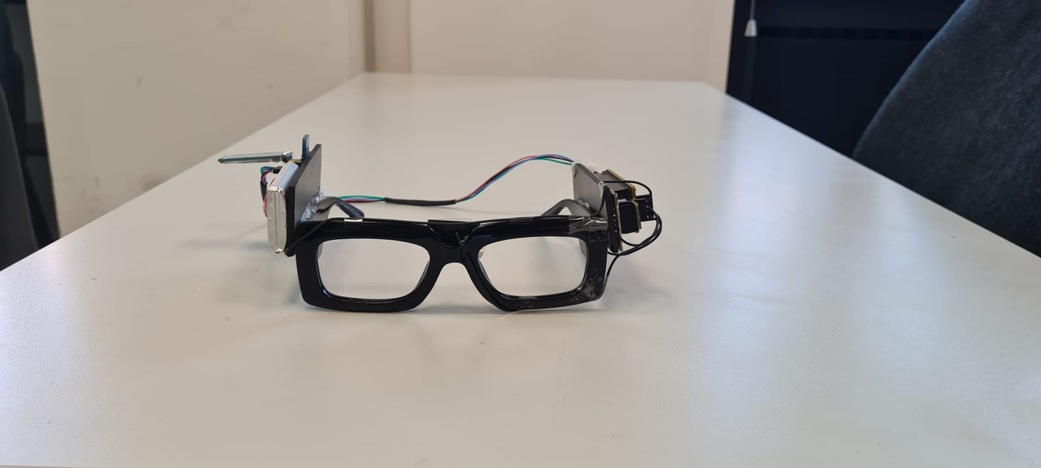
SMART GLASSES
FOR FACIAL RECOGNITION
Project made by:
Alessandro Palmieri
Alessandro Setzi
Alejandro Garrigós
Matteo Ciuffreda

Slide 2



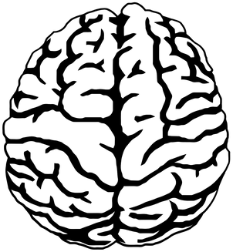
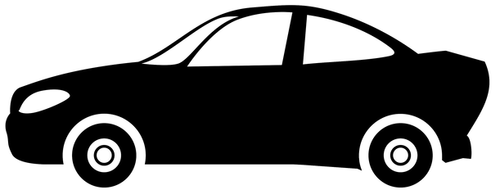

Possible applications
Z
Z
Z
01
02
03
04
Know the needs of the subject in real time, without the need of a nurse to intervene.
Communicate with the subject even if they aren't able to speak
Control the status of subjects in neurological surgeries
Help in the detection of a sleepy driver

Slide 3

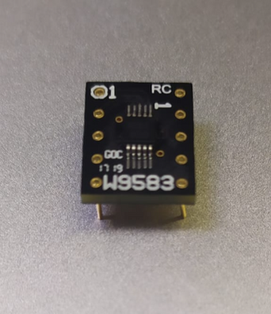
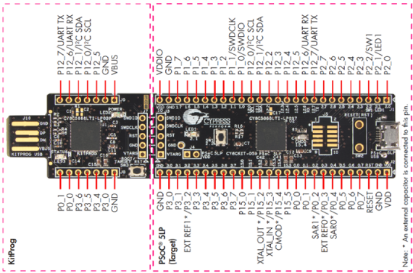
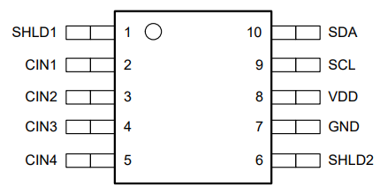
Basic electrical components
FDC1004Q Sensor
Microcontroller
Psoc 5LP microcontroller used to read the output of the sensor and send it to the computer.
Capacitive sensor used to measure the capacity of the electrodes placed at the glasses.

Slide 4
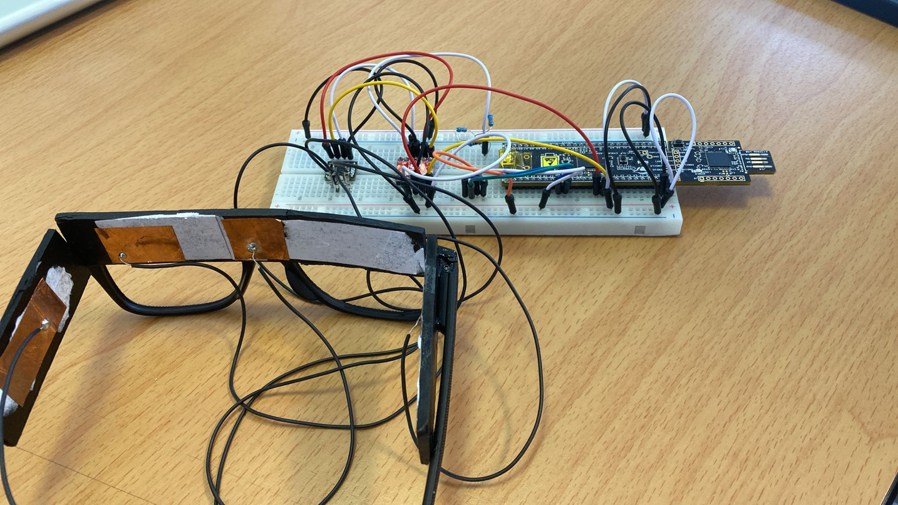
First prototype
Prototype of the glasses testing the position of the electrodes.
Initial breadboard used to test the sensor using the level converter

Slide 5
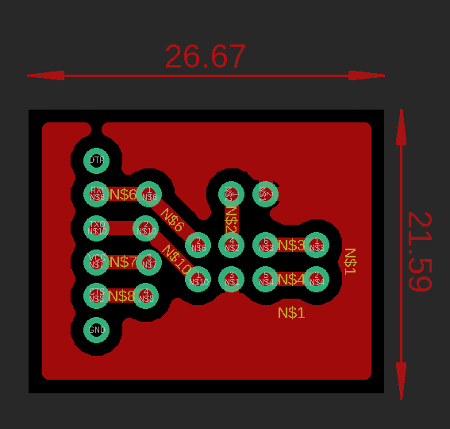
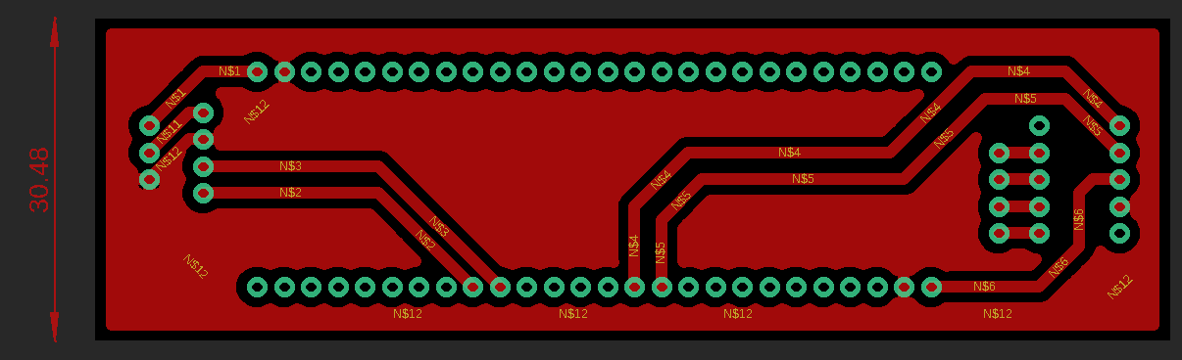
PCBs board design
Bluetooth
Switch
Battery
Recharger
Psoc
Sensor
Electrodes connections
Stabilizer (3.3V)

Slide 6

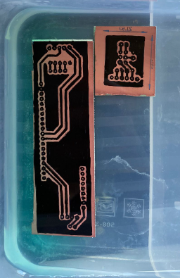
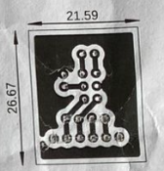

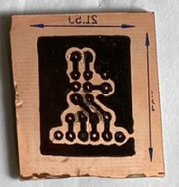
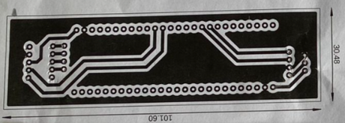
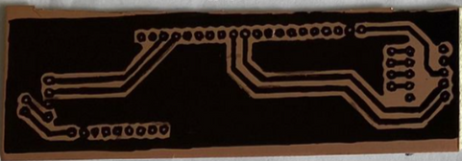
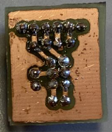
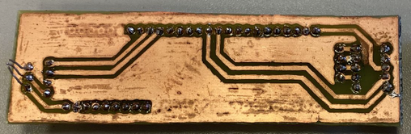
PCBs preparation
Print schematics on paper
Print schematics on PCB
Acid bath to define the paths of the circuits
Components soldering to the PCB

Slide 7

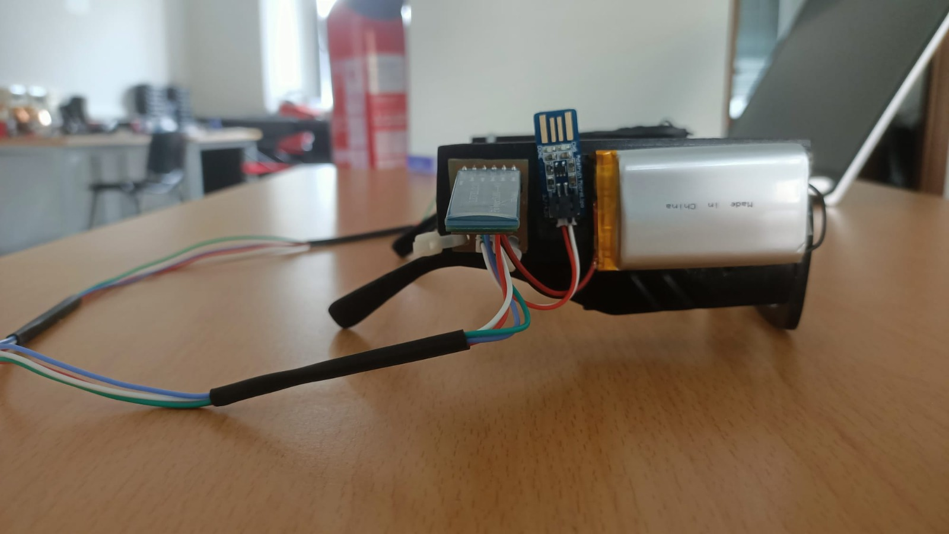
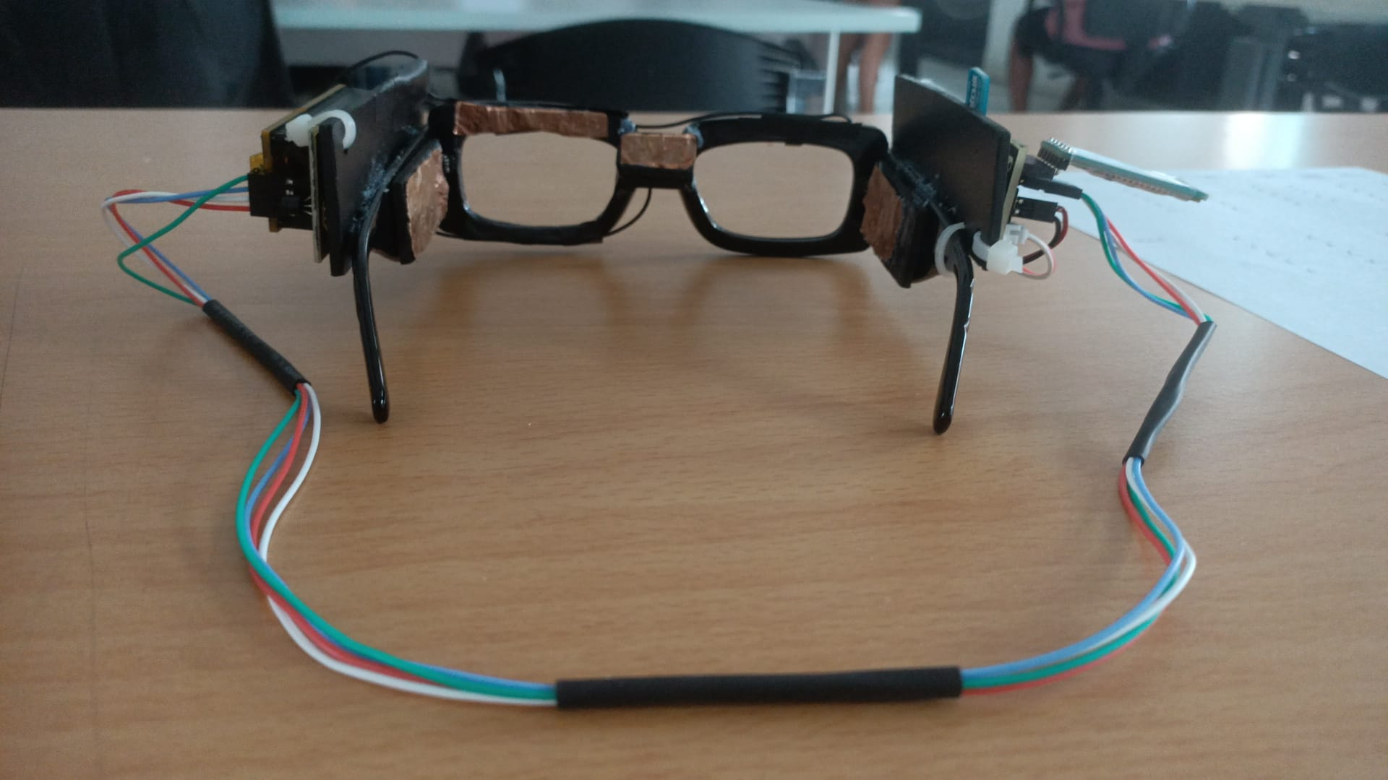
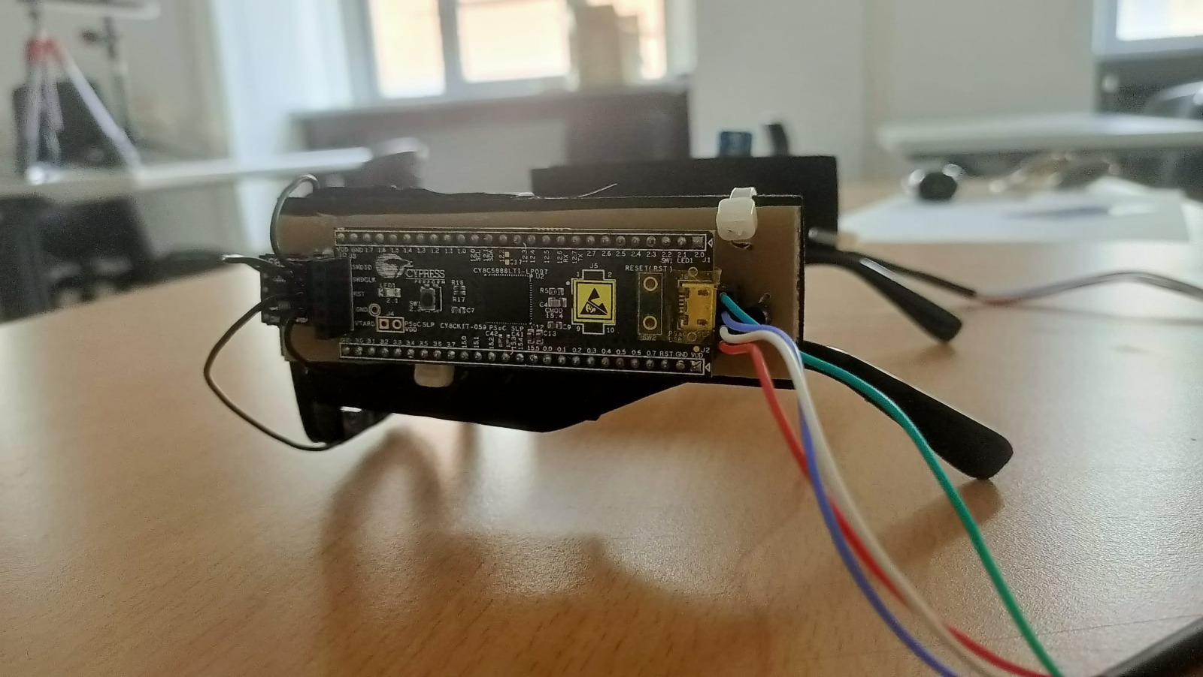
Final prototype

Slide 8
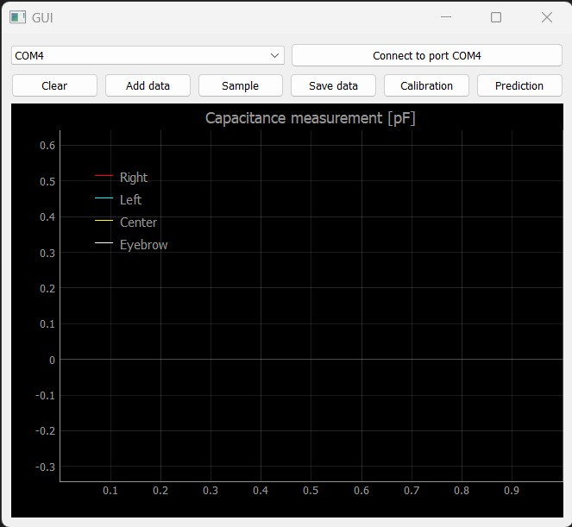
Acquisition process
Connection to the right Bluetooth COM
Press "Calibration" to calibrate the subject
Press "Add data" to visualise the signals
Press "Clear" to remove the visualized data
Press "Sample" to acquire the signal obtained
Press "Save data" to save the values
Press "Prediction" to see the guess of the expression

Slide 9
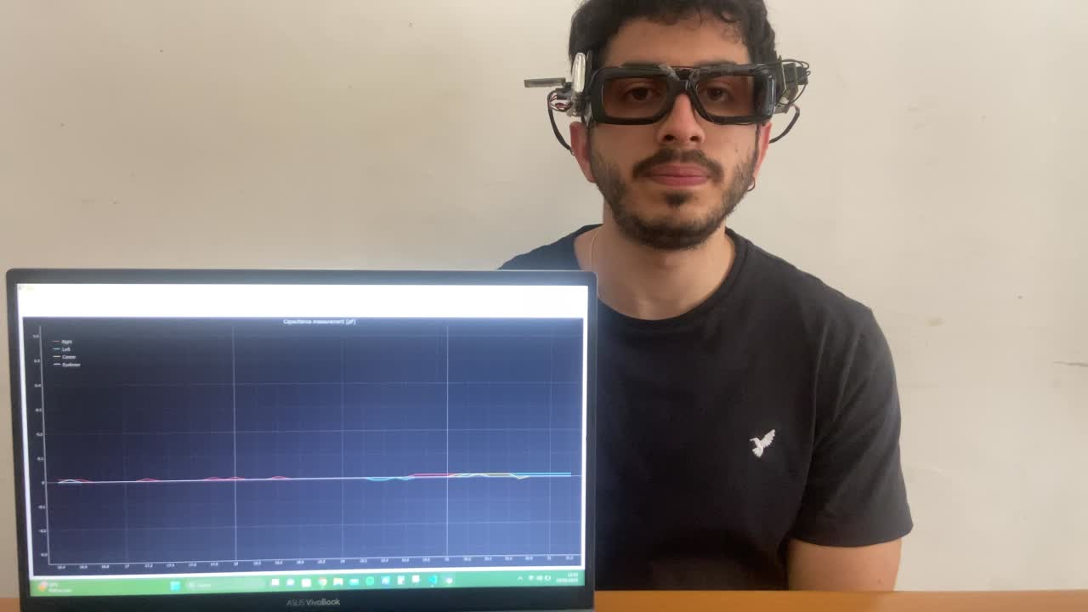
Video demonstration

Slide 10
Database preparation
A total of 19 different people
Each one made 5 facial expressions
Each expression was repeated 10 times
Final database of 950 acquisitions

Slide 11
Machine learning modeling
File generation for each expression
Feature extraction
Mean
Variance
Mode
Maximum
Minimum
Modeling selection

Slide 12
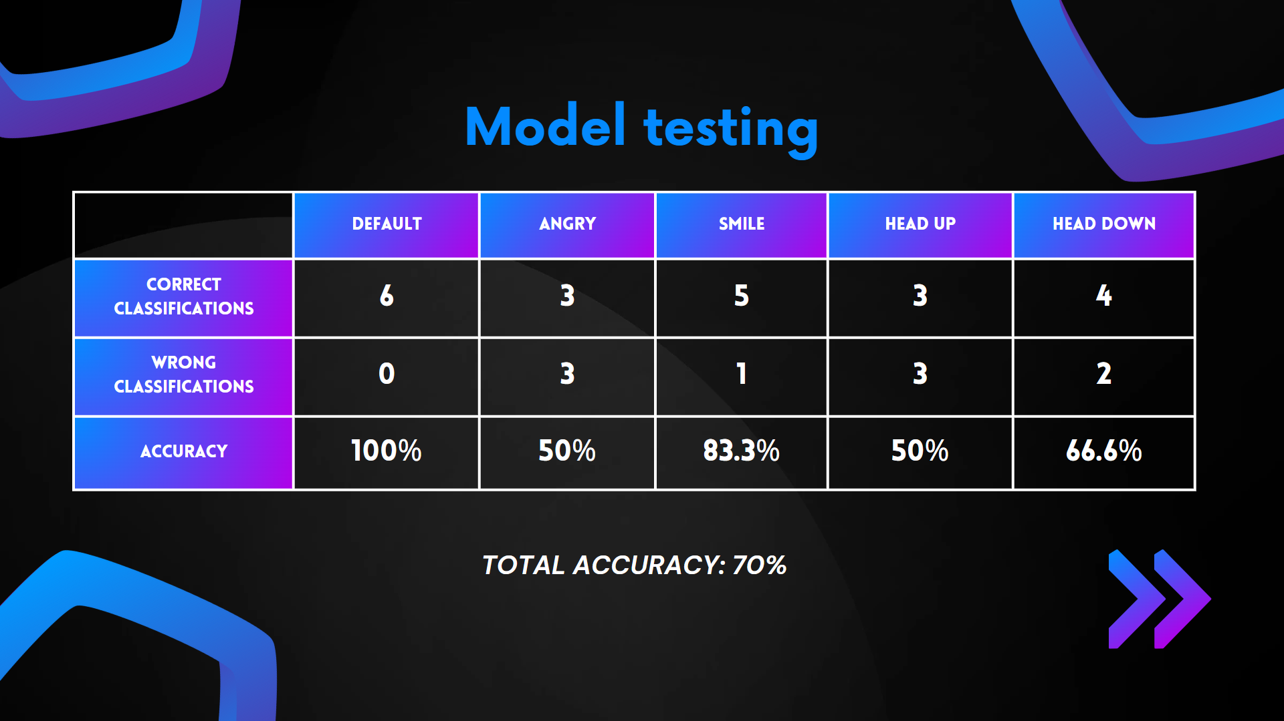

Slide 13
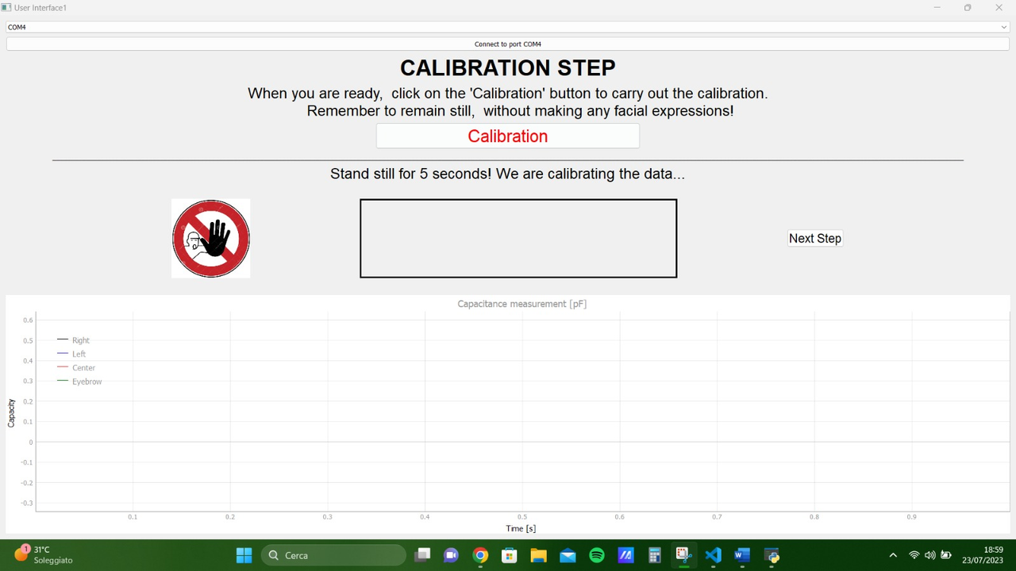
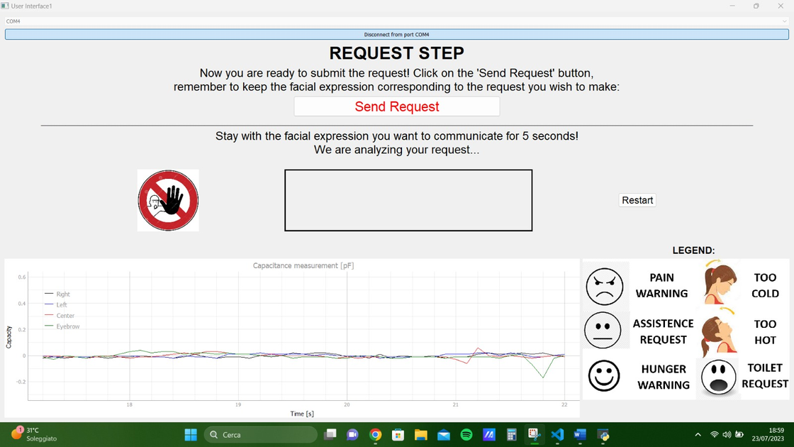
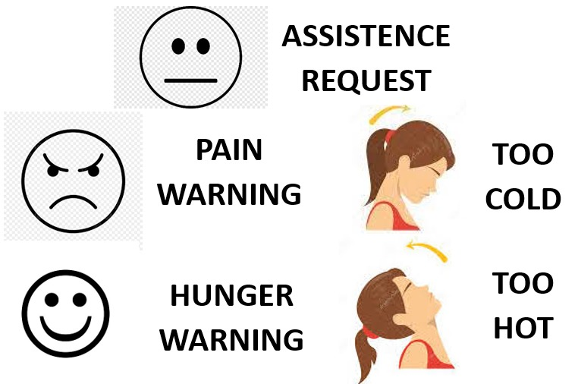
Graphical User Interface
Window to directly interact with the subject
Two different windows:
To calibrate the glasses
To process the request
The subject has the legend
to see which expression correspond
to each need

Slide 14
IMPROVEMENTS
Facial expressions that get confused
Great variability between subject’s expression
Increase the size of the dataset to get better results
Minimize components size
High component size and poor ergonomics of glasses
Multiple glasses sizes
Different head dimensions

Slide 15
THANK YOU FOR
YOUR ATTENTION

